Slide 1
Operating Systems
计算机科学与技术学院
高海昌
hchgao@xidian.edu.cn

Slide 2
Processes and Threads
  2.1 Processes （进程）
  2.2 Threads（线程）
  2.3 Scheduling（调度）
  2.4 Interprocess communication（进程间通信）
  2.5 Classical IPC problems （经典IPC问题）

Slide 3
Interprocess Communication
There is a need for communication between processes, preferably in a well-structured way not using interrupts.
Three issues to care:
  How one process can pass information to another.
  Making sure two or more processes do not get into each other’s way when engaging in critical activities.
  Concerns proper sequencing when dependencies are present.

Slide 4

Race Conditions
Two processes want to access shared memory at same time
Race conditions: Two or more processes are reading or writing some shared data and the final result depends on who runs precisely when.

Slide 5
Critical Regions 临界区
Four conditions to provide mutual exclusion 互斥:
No two processes simultaneously in critical region
No assumptions made about speeds or numbers of CPUs
No process running outside its critical region may block another process
No process must wait forever to enter its critical region
Critical region: The part of the program where the shared memory is accessed.

Slide 6

Critical Regions (2)
Mutual exclusion using critical regions

Slide 7
Mutual Exclusion with Busy Waiting
Various proposals for achieving mutual exclusion
  Disable Interrupts 禁止中断.
  Lock Variables 锁变量.
  Strict Alternation 严格轮换法.
  Peterson’s Solution Peterson解法.
  The TSL Instruction TSL指令.

Slide 8
Disable Interrupts 禁止中断
Let each process disable all interrupts just after entering its critical region and re-enable them just before leaving it.
  It is unwise to give user processes the power to turn off interrupts.
  Not work in multiple CPU system.
  But it is convenient for the kernel to disable interrupts for a few instructions while it is updating variables or lists.

Slide 9
Lock Variables 锁变量
Have a single, shared (Lock) variable.
  It contains the same problem that we saw in the spooler directory. (V=0, get in; V=1, keep out.)

Slide 10
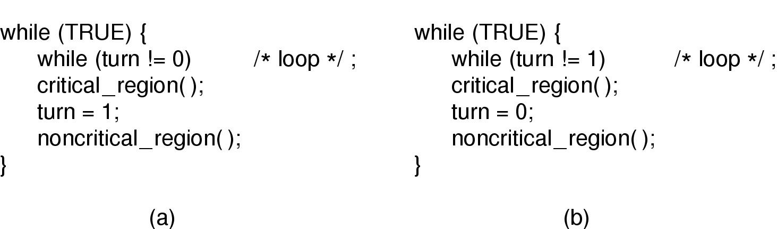
Strict Alternation 严格轮换法
Proposed solution to critical region problem
  (a) Process 0. (b) Process 1.
This solution require that the two processes strictly alternate in entering their critical regions.
This solution violates condition 3 (a fast process have to wait another).

Slide 11
Strict Alternation 严格轮换法
Proposed solution to critical region problem
  (a) Process 0. (b) Process 1.
Continuously testing a variable until some value appears is called busy waiting.
A lock that uses busy waiting is called a spin lock.

Slide 12
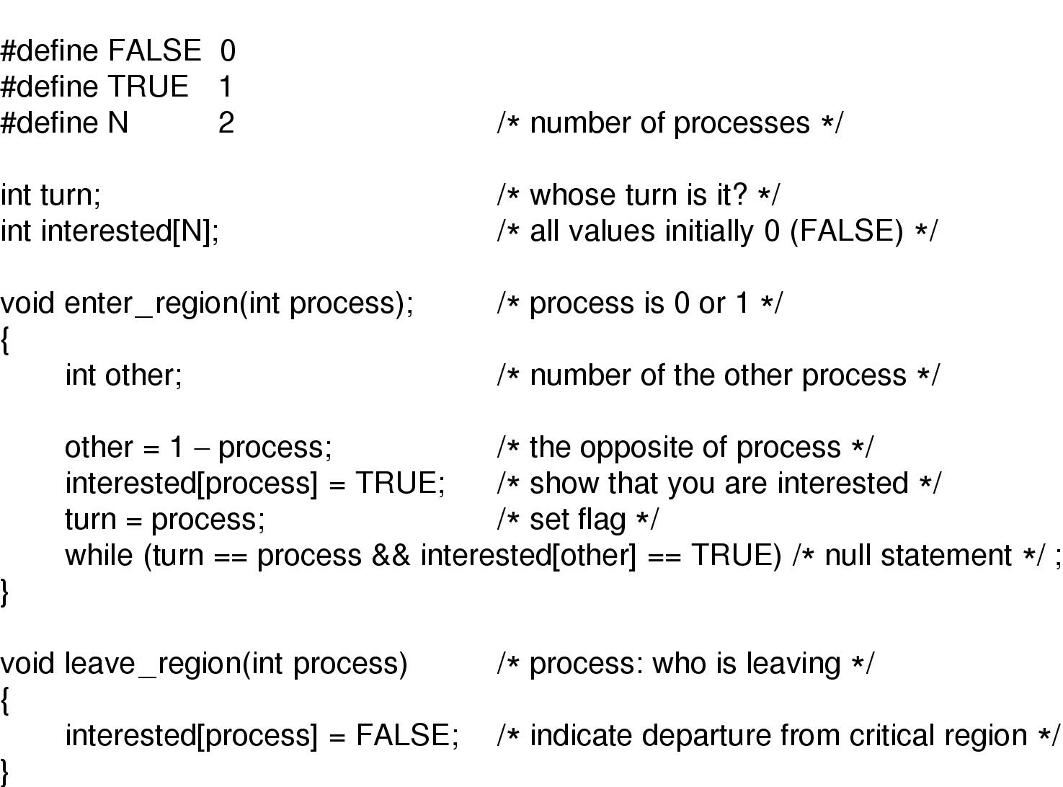
Peterson’s Solution
Peterson's solution for achieving mutual exclusion

Slide 13
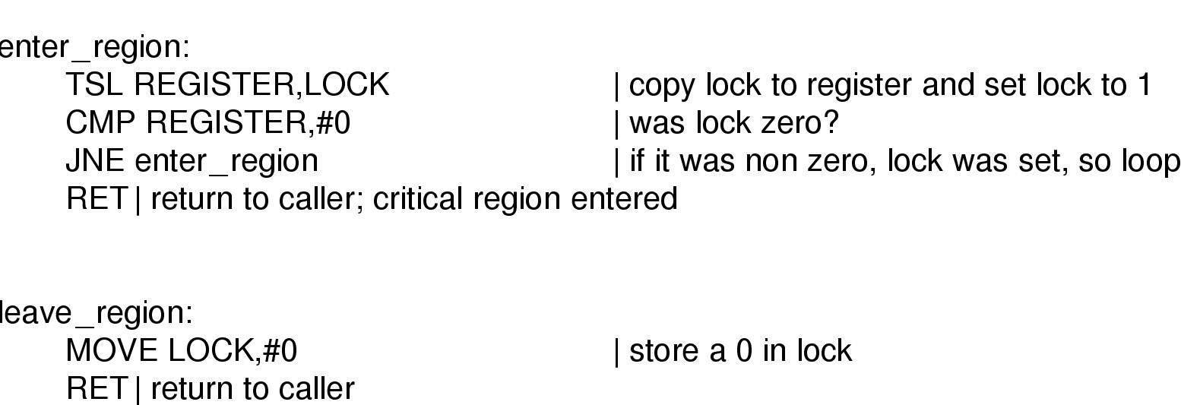
TSL instruction
TSL: Test and Set Lock (Require a little help from the hardware)
TSL RX, LOCK
It reads the contents of the memory word lock into register RX and then stores a nonzero value at the memory address lock. The operations of reading the word and storing into it are guaranteed to be indivisible.
Entering and leaving a critical region using the
TSL instruction

Slide 14
Sleep and Wakeup
Both Peterson and TSL solutions are correct, but both have the defect of requiring busy waiting.
  Waste CPU time.
  Priority inversion problem (lower priority process can not quit critical region).
Some IPC primitives: sleep and wakeup. (Block instead of busy waiting)

Slide 15
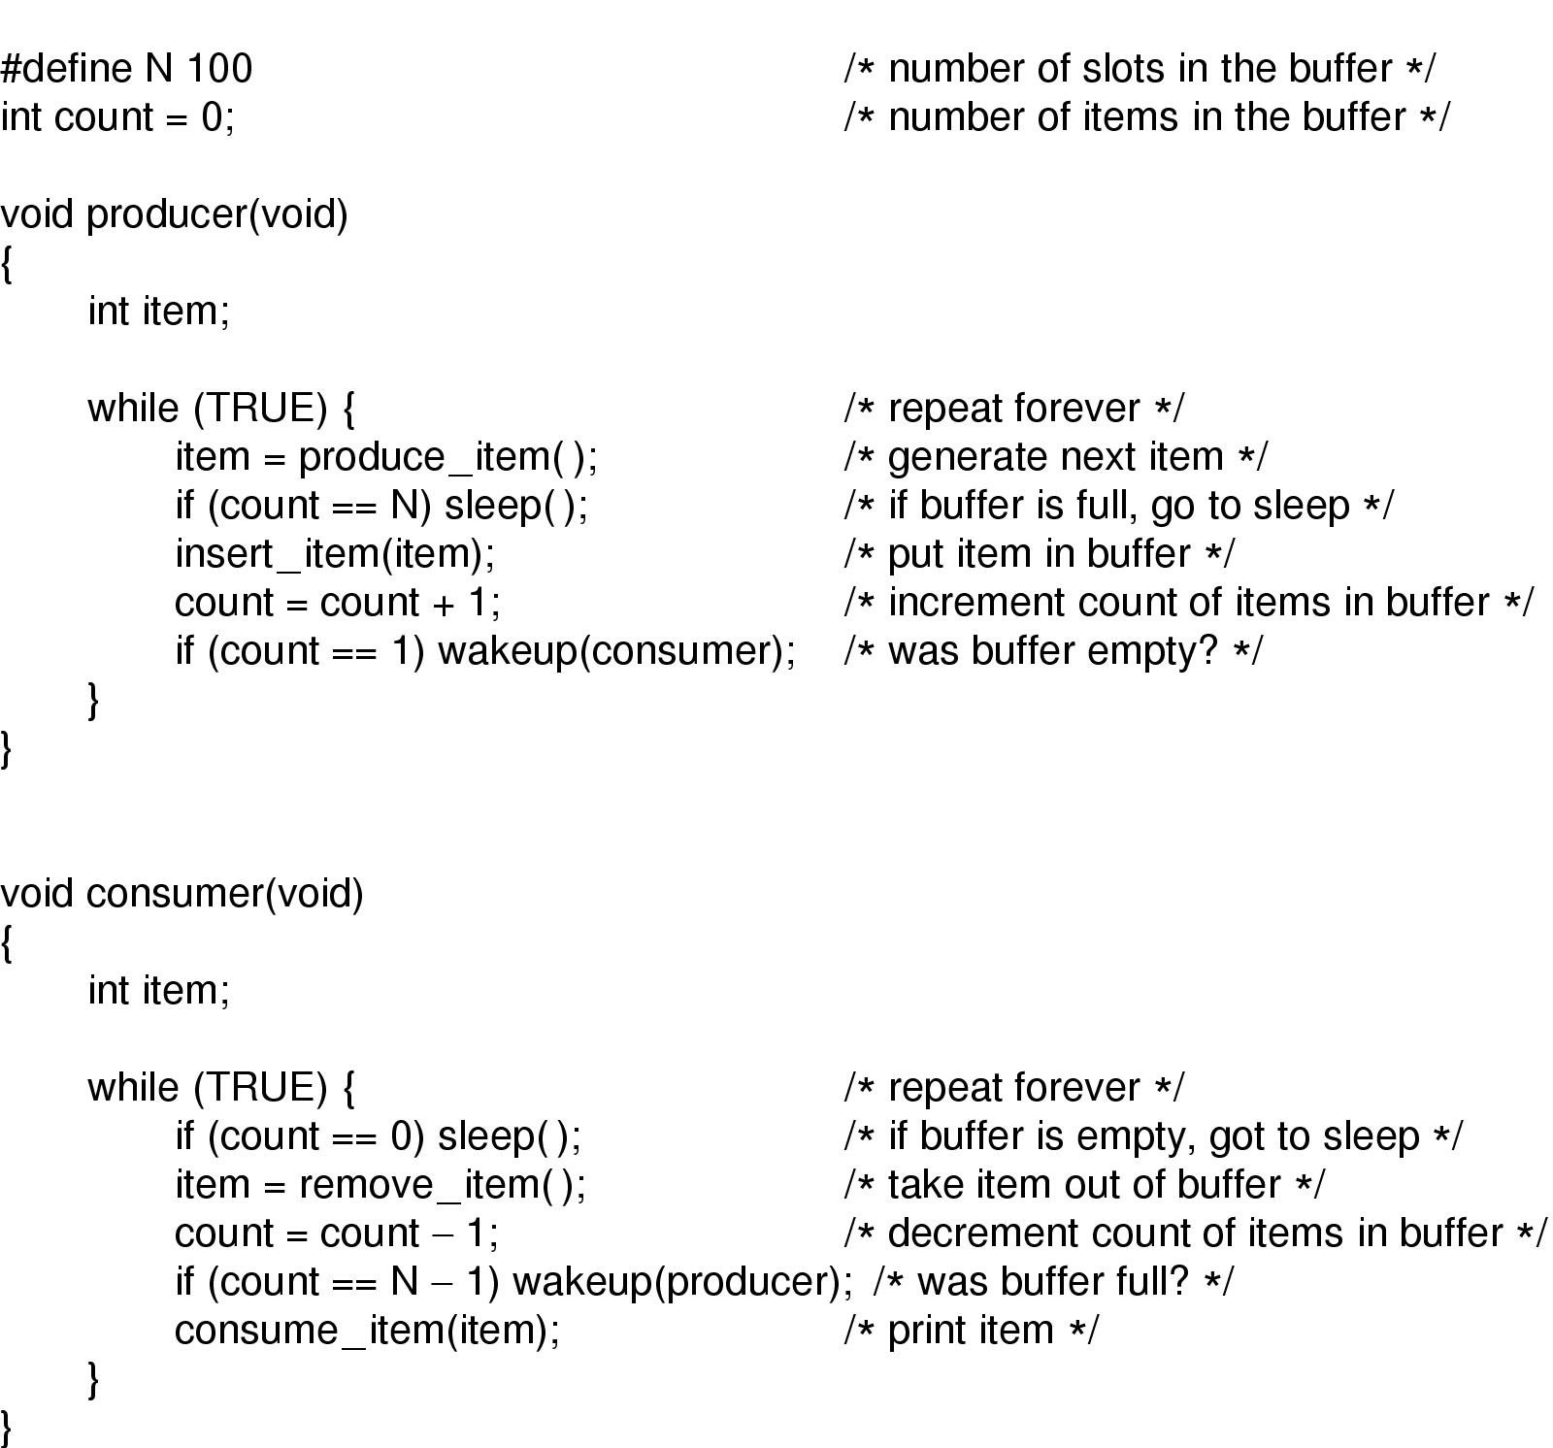
Sleep and Wakeup (2)
Problem: race condition can occur because access to count is unconstrained.
A wakeup sent to a process that is not (yet) sleeping may be lost.
Solution: wakeup waiting bit
Producer-consumer problem with fatal race condition
Notes:
Producer执行到count=count+1=2，CPU转去执行consumer的count=count-1=1，CPU再返回执行prodocer的if(count==1)成立，wakeup唤醒丢失。

Slide 16
Semaphore 信号量
Synchronization tool that does not require busy waiting.
Semaphore S – integer variable to count the number of wakeups saved for future use.
can only be accessed via two indivisible (atomic) operations
P (S): while S≤ 0 do no-op;
S--;
V(S): S++;
Down操作
Up操作
Notes:
信号量

Slide 17
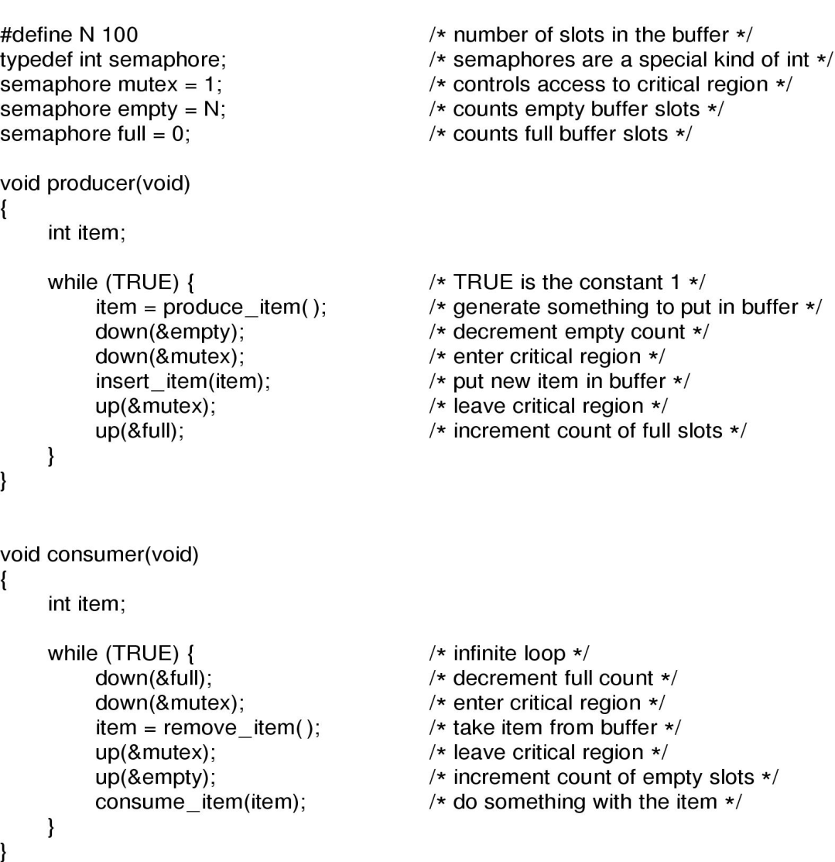
Semaphores
The producer-consumer problem using semaphores

Slide 18
PV操作
含义：PV操作由P操作原语和V操作原语组成（原语是不可中断的过程），对信号量进行操作，具体定义如下：
P（S）：①将信号量S的值减1，即S = S - 1；
②如果s >= 0，则该进程继续执行；否则该进程置为等待状态，排入等待队列。
V（S）：①将信号量S的值加1，即S = S + 1；
②如果S > 0，则该进程继续执行；否则释放队列中第一个等待信号量的进程。
信号量在创建时需要设置一个初始值，表示同时可以有几个任务可以访问该信号量保护的共享资源。初始值为1就变成互斥锁（Mutex），即同时只能有一个任务可以访问信号量保护的共享资源。
Notes:
信号量

Slide 19
PV操作
意义：我们用信号量及PV操作来实现进程的同步和互斥。PV操作属于进程的低级通信。
什么是信号量？信号量（semaphore）的数据结构为一个值和一个指针，指针指向等待该信号量的下一个进程。信号量的值与相应资源的使用情况有关。当它的值大于0时，表示当前可用资源的数量；当它的值小于0时，其绝对值表示等待使用该资源的进程个数。注意，信号量的值仅能由PV操作来改变。
一般来说，信号量S >= 0时，S表示可用资源的数量。执行一次P操作意味着请求分配一个单位资源，因此S的值减1；当S<0时，表示已经没有可用资源，请求者必须等待别的进程释放该类资源，它才能运行下去。而执行一个V操作意味着释放一个单位资源，因此S的值加1；若S <= 0，表示有某些进程正在等待该资源，因此要唤醒一个等待状态的进程，使之运行下去。
Notes:
信号量

Slide 20
Semaphore (example 1)
n processes shared one segment, if allow m(m<n) processes enter the mutual segment simultaneously, then the value range of semaphore is ______ .
A. –m~1
B. –m~0
C. –(n-m)~m
D. –(m-1)~n .
Notes:
信号量

Slide 21
Semaphore (example 2)
In the process management, if the initial value of semaphore S is 2 and the current value is -1, then there are ____ processes waiting for this resource.
A. 0
B. 1
C. 2
D. 3
Notes:
信号量

Slide 22
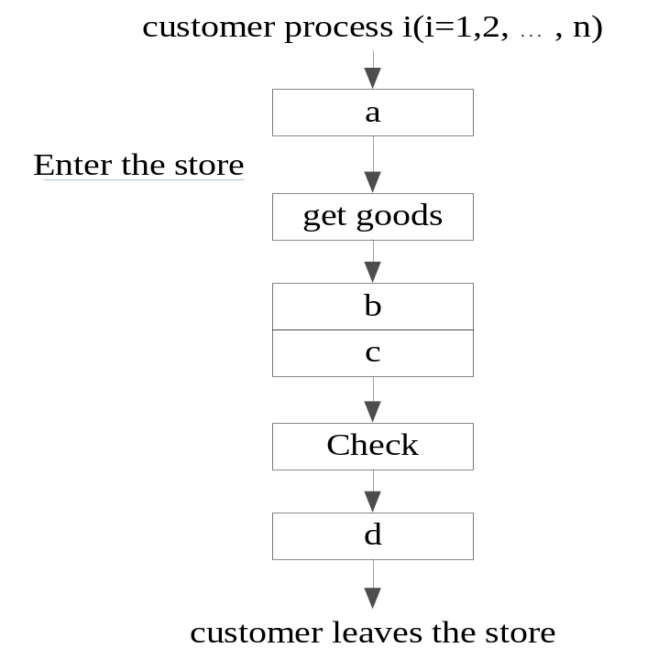
Semaphore (example 3)
A store has two consigners (发货员), one checker. when customer want to pick up the goods, if one of the consigner is idle, the customer is allowed to get into the store and take the goods. when customer leaves, the checker examines whether customer gets the right goods. To coordinate their works using PV operations, two semaphore S1 and S2 are used. The initial value of S1 is 2, and the initial value of S2 is 1. the operation in ‘a’ shown in the following figure should be (1); the operation in ‘b’, ‘c’ and ‘d’ should be (2) .
(1) A. P(S1) B. P(S2)
C. V(S1) D. V(S2)
(2) A. P(S2)、V(S2) and V(S1)
B. P(S1)、V(S1) and V(S2)
C. V(S1)、P(S2) and V(S2)
D. V(S2)、P(S1) and V(S1)
Notes:
信号量

Slide 23
Linux supports Kernel semaphores, POSIX semaphores and System V semaphores.
The System V semaphore API documents that the semaphoer value cann't be less than 0.
The POSIX semaphore API documents that "If sem is locked, then the object to which sval points shall either be set to zero or to a negative number whose absolute value represents the number of processes waiting for the semaphore at some unspecified time during the call". It looks like the glibc implementation of POSIX semaphores doesn't allow the semaphore count/value to drop below zero.
Linux kernel semaphores used to have an implementation that tracked waiters using negative counts - this is the implementation that's documented in Bovet & Cesati's "Understanding the Linux Kernel" book. However at some point in the evolution of the 2.6 kernel, the implementation changed so that the semaphore value doesn't drop below zero.

Slide 24
So all semaphores allow a count greater than zero, which represents some number of resources that can be acquired at the same time. Whether a semaphore count can go below zero is an implementation detail - the behavior of those semaphores as far as waiting on a resource is the same as semaphore implementations that do not let the count drop below zero.
But the use cases where a semaphore count greater than 1 is useful is pretty rare. As Linus Torvalds said in a newsgroup posting (http://yarchive.net/comp/linux/semaphores.html):
Almost all practical use of semaphores is a special case where the counter is initialized to 1, and where they are used as simple mutual exclusion with only one user allowed in the critical region. Such a semaphore is often called a "mutex" semaphore for MUTual EXclusion.

Slide 25
Mutexes 互斥信号量
A simplified version of the semaphone.
  When the count ability is not needed.
  Good only for managing mutual exclusion to some shared resource or piece of code.
  Useful in thread packages that are implemented entirely in user space
  A mutex is a variable that can be in one of two states: unlocked or locked.

Slide 26
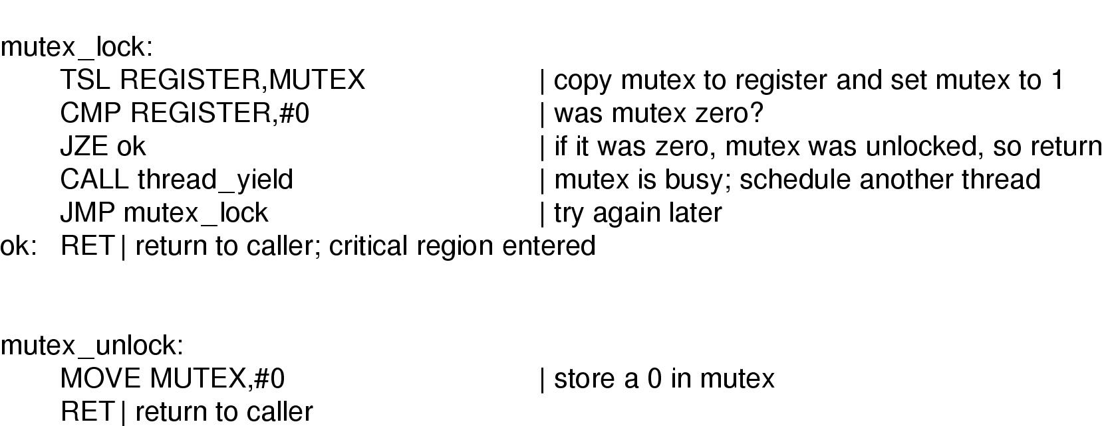
Mutexes (2)
Implementation of mutex_lock and mutex_unlock

Slide 27
Mutexes (3)
Similar to the code of enter_region but with a crucial difference.
When enter_region fails to enter the critical region, it busy waiting. The clock runs out and some other process is scheduled to run.
But there is no clock that stops threads that have run too long. When the mutex_lock fails to acquire a lock, it calls thread yield to give up the CPU to another thread. There is no busy waiting.

Slide 28
Mutexes ()
Note:
With a user-space threads package there is no problem with multiple threads having access to the same mutex, since all the threads operate in a common address space.
However, with Peterson’s algorithm and semaphores, there is an unspoken assumption that multiple processes have access to at least some shared memory, perhaps only one word. What if processes have disjoint address spaces?
There are two answers.
First, some of the shared data structures, such as the semaphores, can be stored in the kernel and accessed only by means of system calls.
Second, most modern OS offer a way for processes to share some portion of their address space with other processes.

Slide 29
Monitors 管程
With semaphores IPC looks easy, right?
  Possible deadlock (slide 16).
A monitor is a collection of procedures, variables, and data structures that are all grouped together in a special kind of module or package.
  Processes may call the procedures in a monitor whenever they want to, but they cannot directly access the monitor’s internal data structures from procedures declared outside the monitor.
  Only one process can be active in a monitor at any instant.

Slide 30
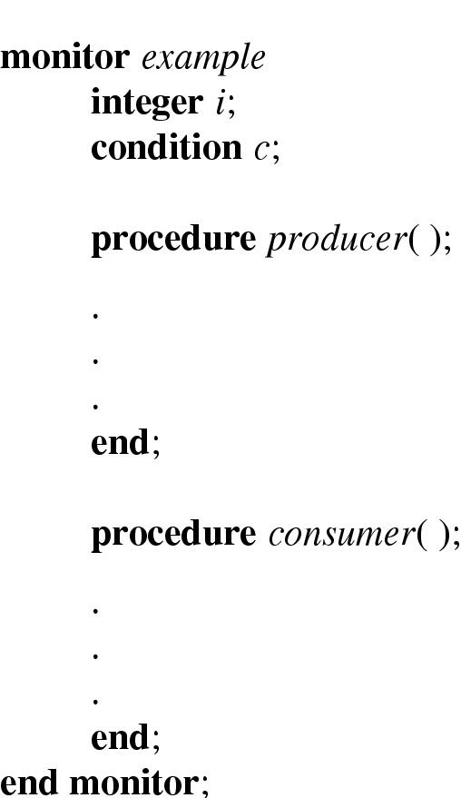
Monitors (2)
Example of a monitor

Slide 31
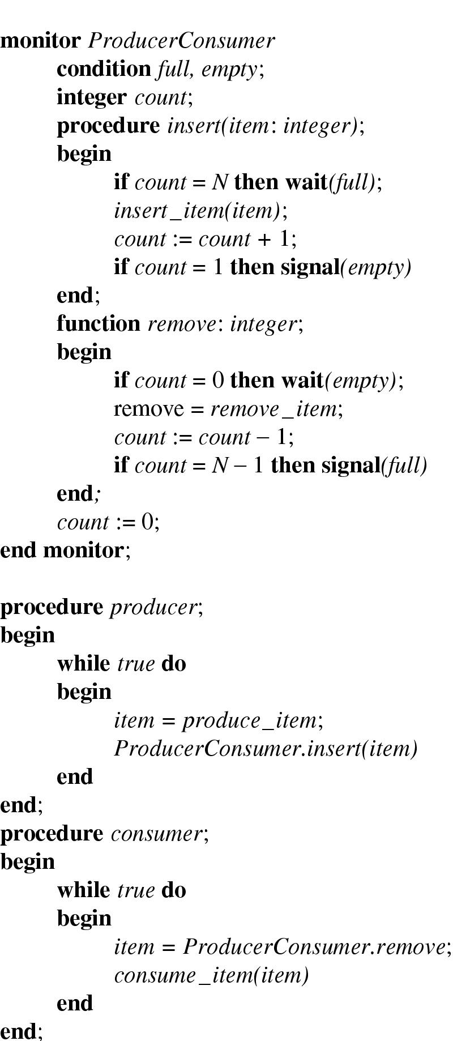
Monitors (3)
Outline of producer-consumer problem with monitors
  only one monitor procedure active at one time
  buffer has N slots

Slide 32
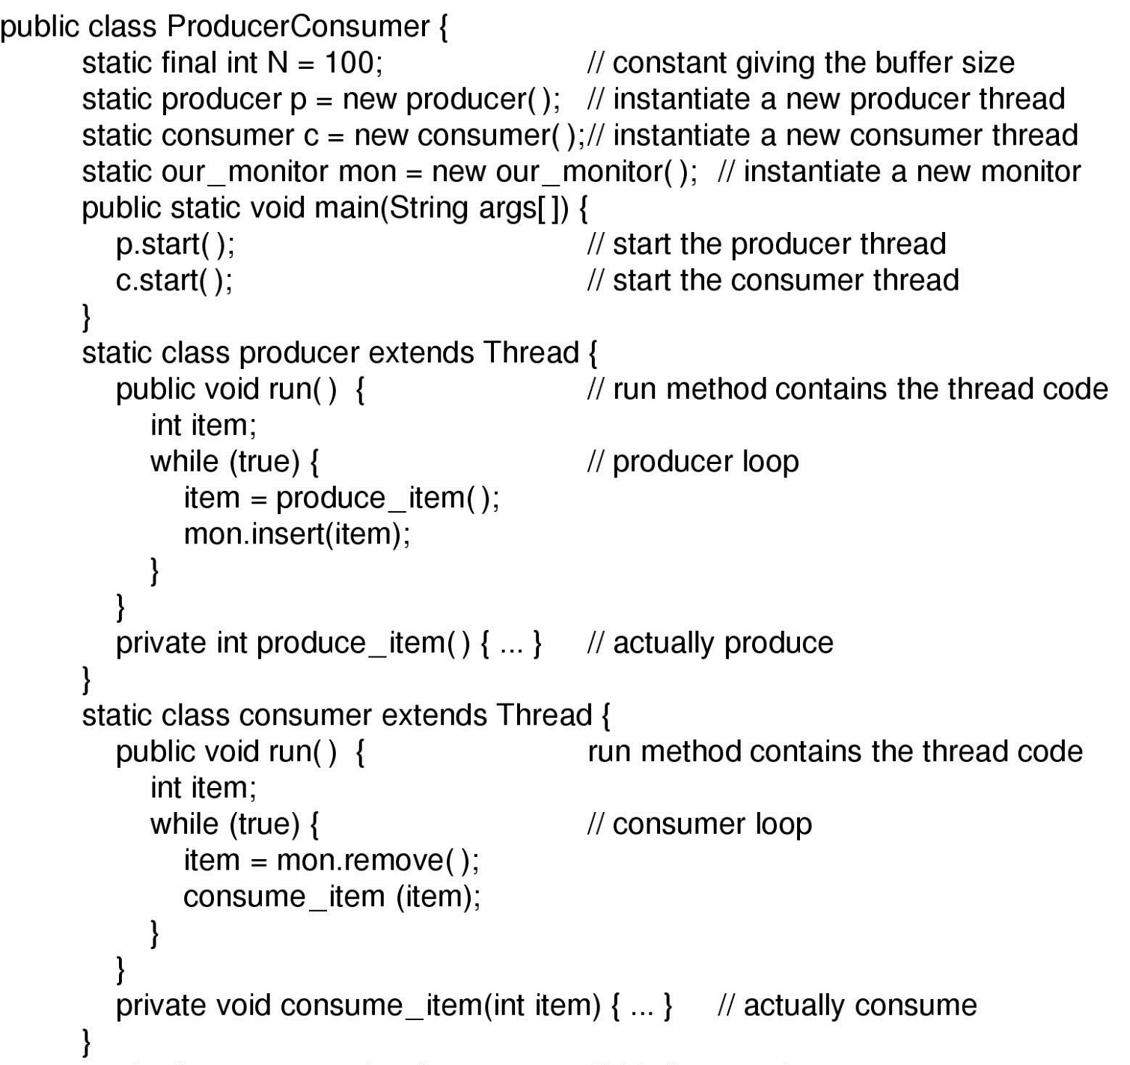
Monitors (4)
Solution to producer-consumer problem in Java (part 1)

Slide 33
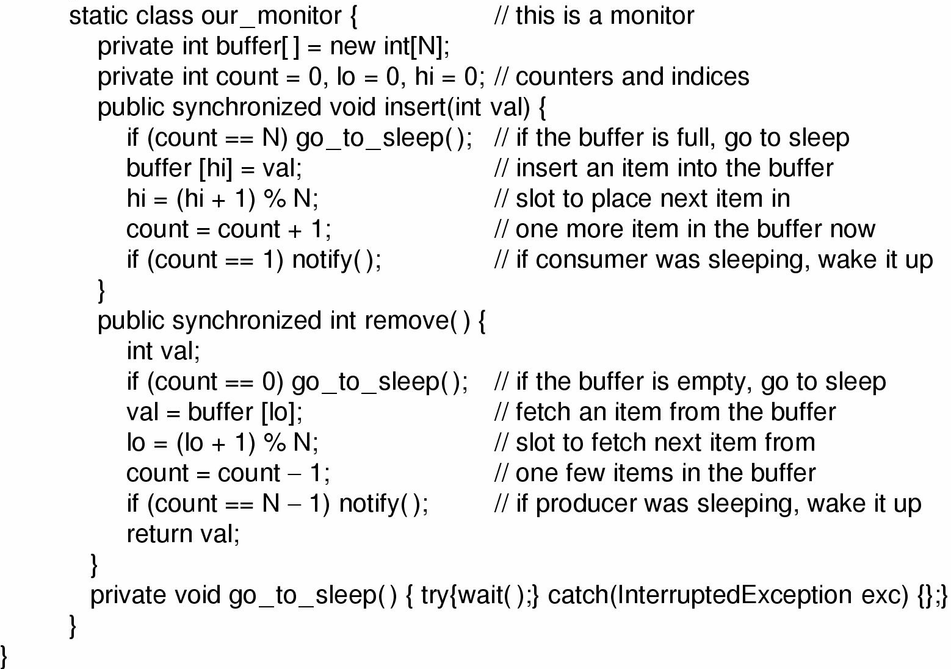
Monitors (5)
Solution to producer-consumer problem in Java (part 2)

Slide 34
Monitors (6)
Drawback
  C, Pascal, and most other language do not have monitors.
Another problem with monitors, and also with semaphores, is that they were designed for solving the mutual exclusion problem in one or more CPUs that all have access to a common memory. But considering multiple CPUs, each with its own private memory, these primitives become inapplicable.

Slide 35
Message Passing
This method of interprocess communication uses two primitives, send and receive.
Design issues:
  Acknowledgement message to against lost messages.
  Putting consecutive sequence numbers in each original message.
  How processes are named to avoid ambiguous.
  Authentication.

Slide 36
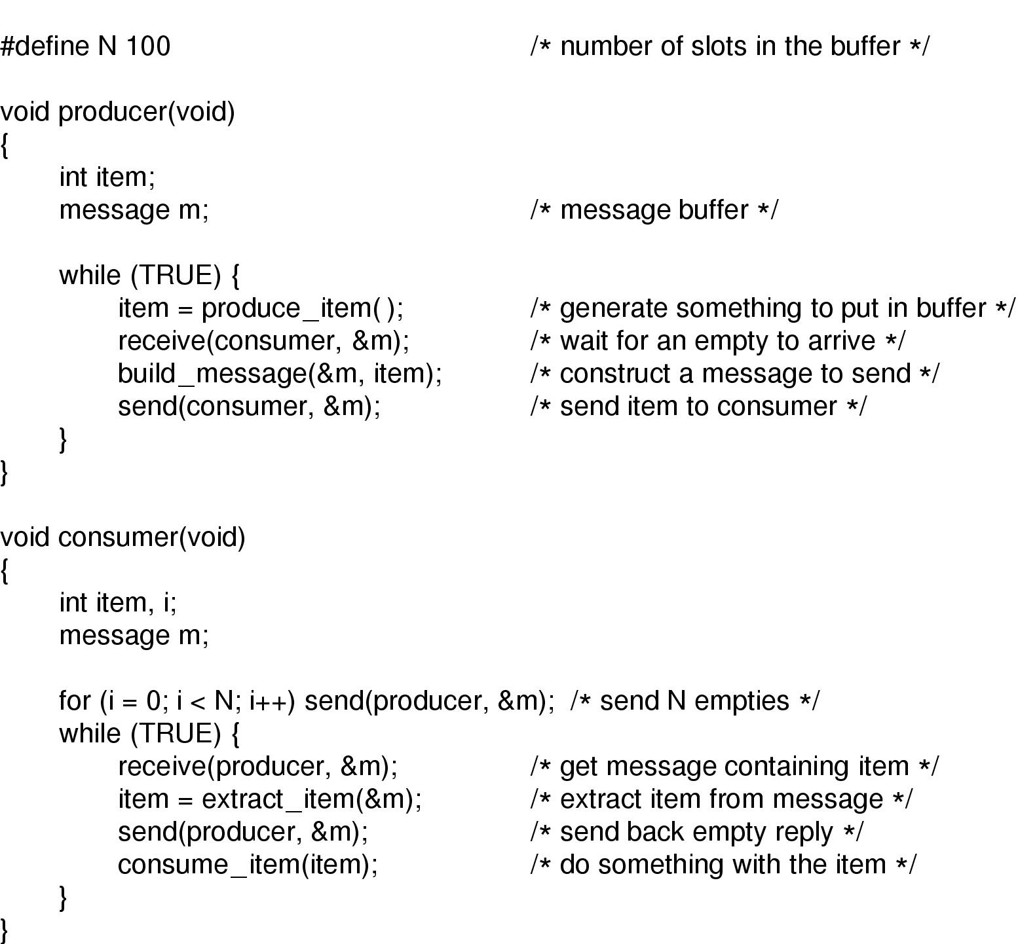
Message Passing (2)
The producer-consumer problem with N messages

Slide 37
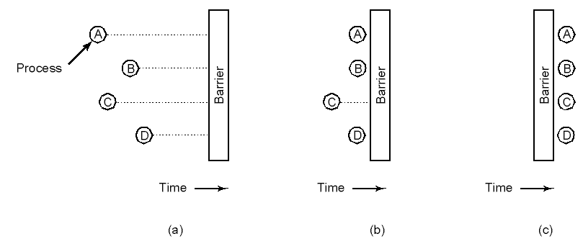
Barriers 屏障
Barriers is intended for groups of processes rather than two-process.
Use of a barrier
  (a) processes approaching a barrier
  (b) all processes but one blocked at barrier
  (c) last process arrives, all are let through

Slide 38
Processes and Threads
  2.1 Processes （进程）
  2.2 Threads（线程）
  2.3 Scheduling（调度）
  2.4 Interprocess communication（进程间通信）
  2.5 Classical IPC problems （经典IPC问题）

Slide 39
Classical IPC problems
Produce / Consumer
Reader /Writer
Dining Philosophers
Sleeping Barber

Slide 40

Dining Philosophers
Philosophers eat/think
Eating needs 2 forks
Pick one fork at a time
How to prevent deadlock

Slide 41
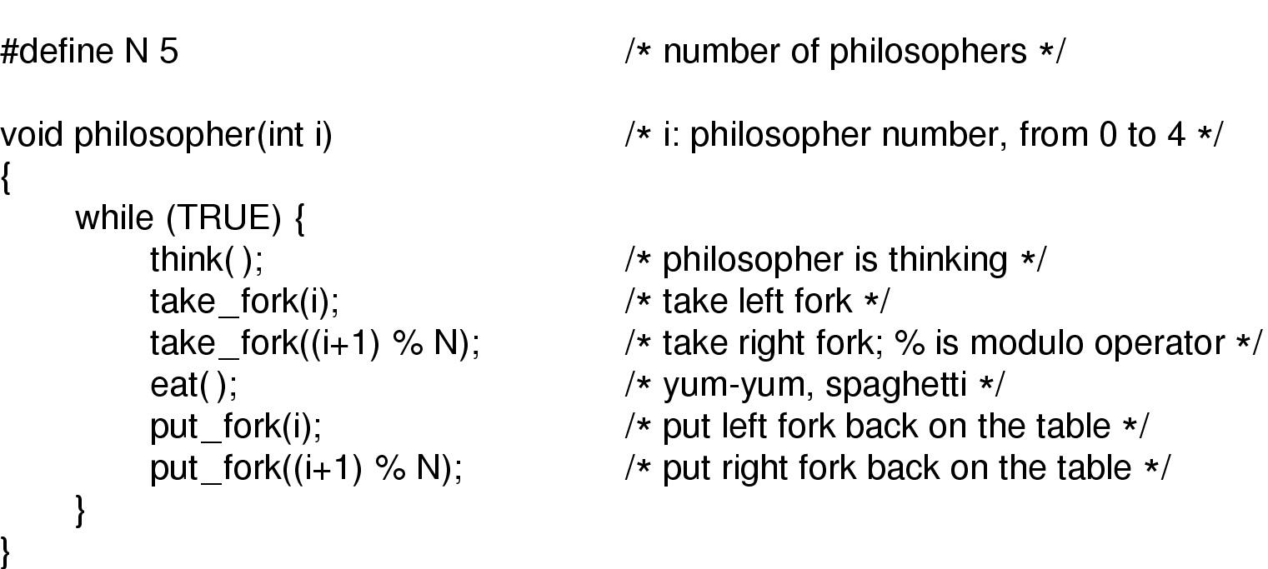
Dining Philosophers (2)
A nonsolution to the dining philosophers problem

Slide 42
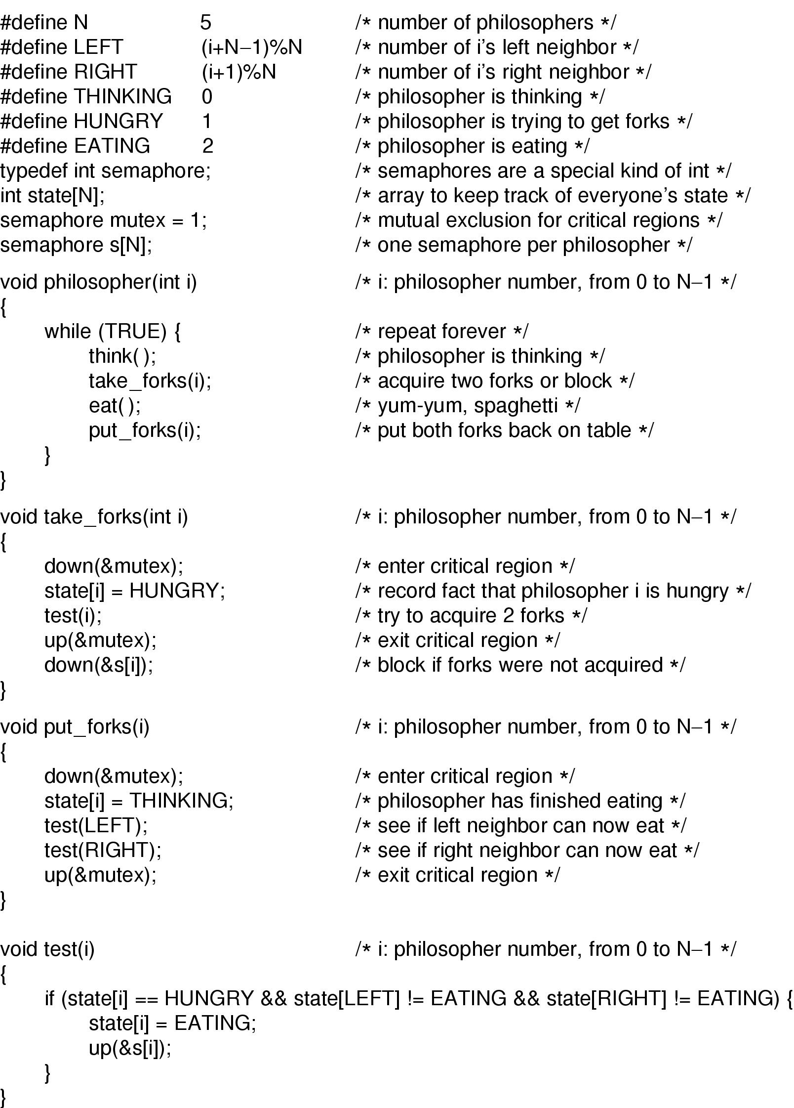
Dining Philosophers (3)
Solution to dining philosophers problem (part 1)

Slide 43
Dining Philosophers (4)
Solution to dining philosophers problem (part 2)

Slide 44
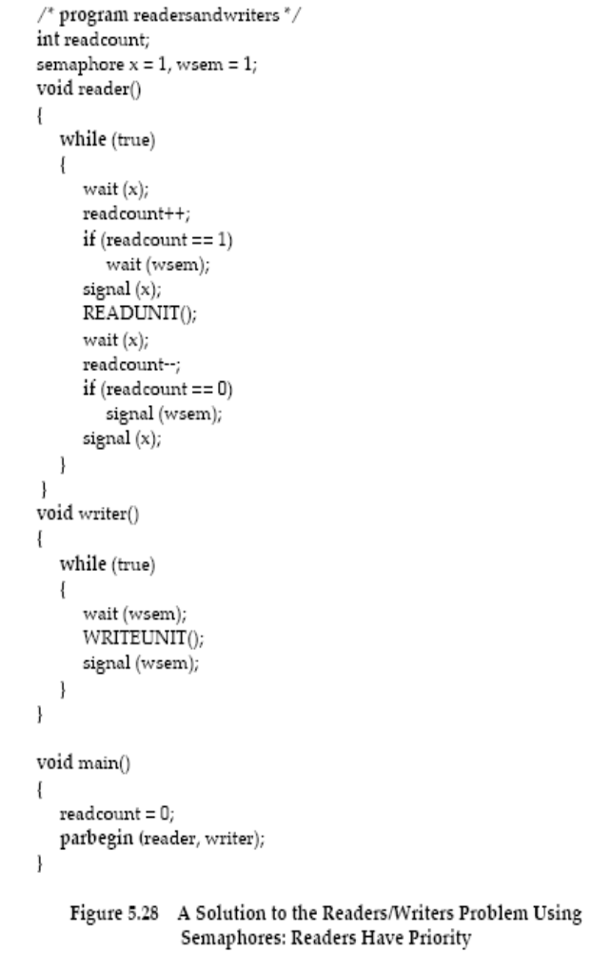
Reader /Writer
A solution to Readers/Writers Problem using Semaphores: Readers Have Priority

Slide 45
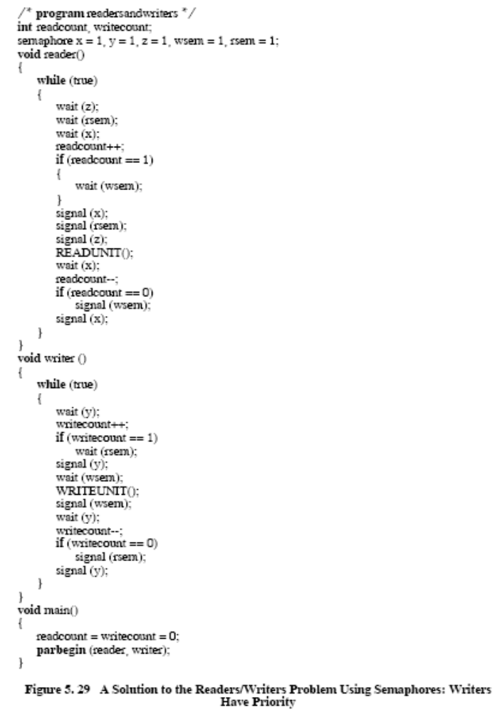
Reader /Writer (2)
A solution to Readers/Writers Problem using Semaphores: Writers Have Priority

Slide 46
Think it over
____________ cannot put the process into sleep.
A. sleep system call
B. I/O operation
C. fork system call
D. operations on semaphore
Notes:
信号量

